Slide 1

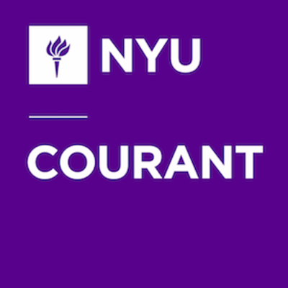
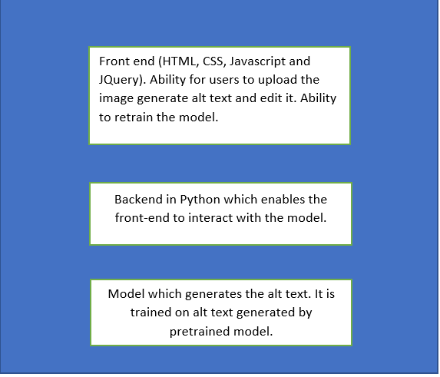

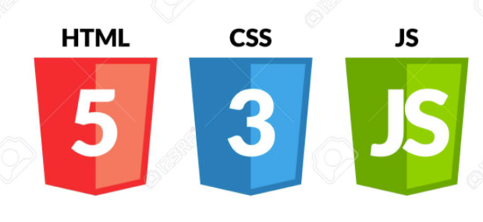
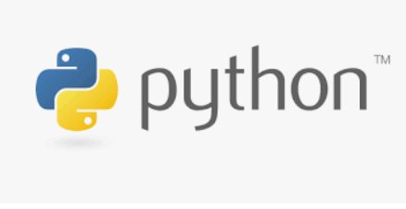
NYPL Improving Accessibility
Team: Abhijeet Sant, Nikita Amlani, Rohit Saraf, Shreya
Supervised by Prof. Jean-Claude Franchitti Project Manager: Sharon Denning
Technical Objectives
Technical Architecture
Sample Workflow
.
The objective of the project was to create a system which would help library to generate alt text for the images of their Digital Collection.
The major components of the application are as follows:
Machine Learning Model which predicts the alt text for images
2.Python Flask application which provides a GUI for uploading image and generating its alt text which can be edited by the library personals. It also provides the ability to retrain the model to ensure constant improvement and generate alt text for all recent images added to the library.
User uploads an image for which they want to generate alt text
A machine learning model generates alt text
The user is shown the generated alt text with an option to edit it and save
Once they save it this changed description will be used to retrain the model.
On click of retrain the model the model will get retrained.
Architecture of Application
Scope
Next Steps
Technology Stack
There are currently limitations in our solution implementation as follows:
1. The accuracy of our machine learning model is limited.Our system provides facility to keep retraining the model and over time this would improve
2. The current system generated alt text and saves it in file. It can be directly tagged to the image on site in future.
3. The model is trained on FSA collection of NYPL, it can be trained on other collections as well.
4. UI can be further improved.
Provide an end to end system that can be used by the library to generate alt text for the images in their digital collection.
Implement API endpoints that can interact with the front-end UI to retrieve data from frontend and interact with our machine learning model.
Provide the library with ability to edit the alt text generated and retrain the model going forward. This will ensure that the model is retrained and keeps improving in performance.
In this project, we used, Flask for backend services, Javascript, HTML and CSS for front-end. Python and HPC server to train ML model. Data source - API provided by NYPL
Notes:
‹#›

